Slide 1
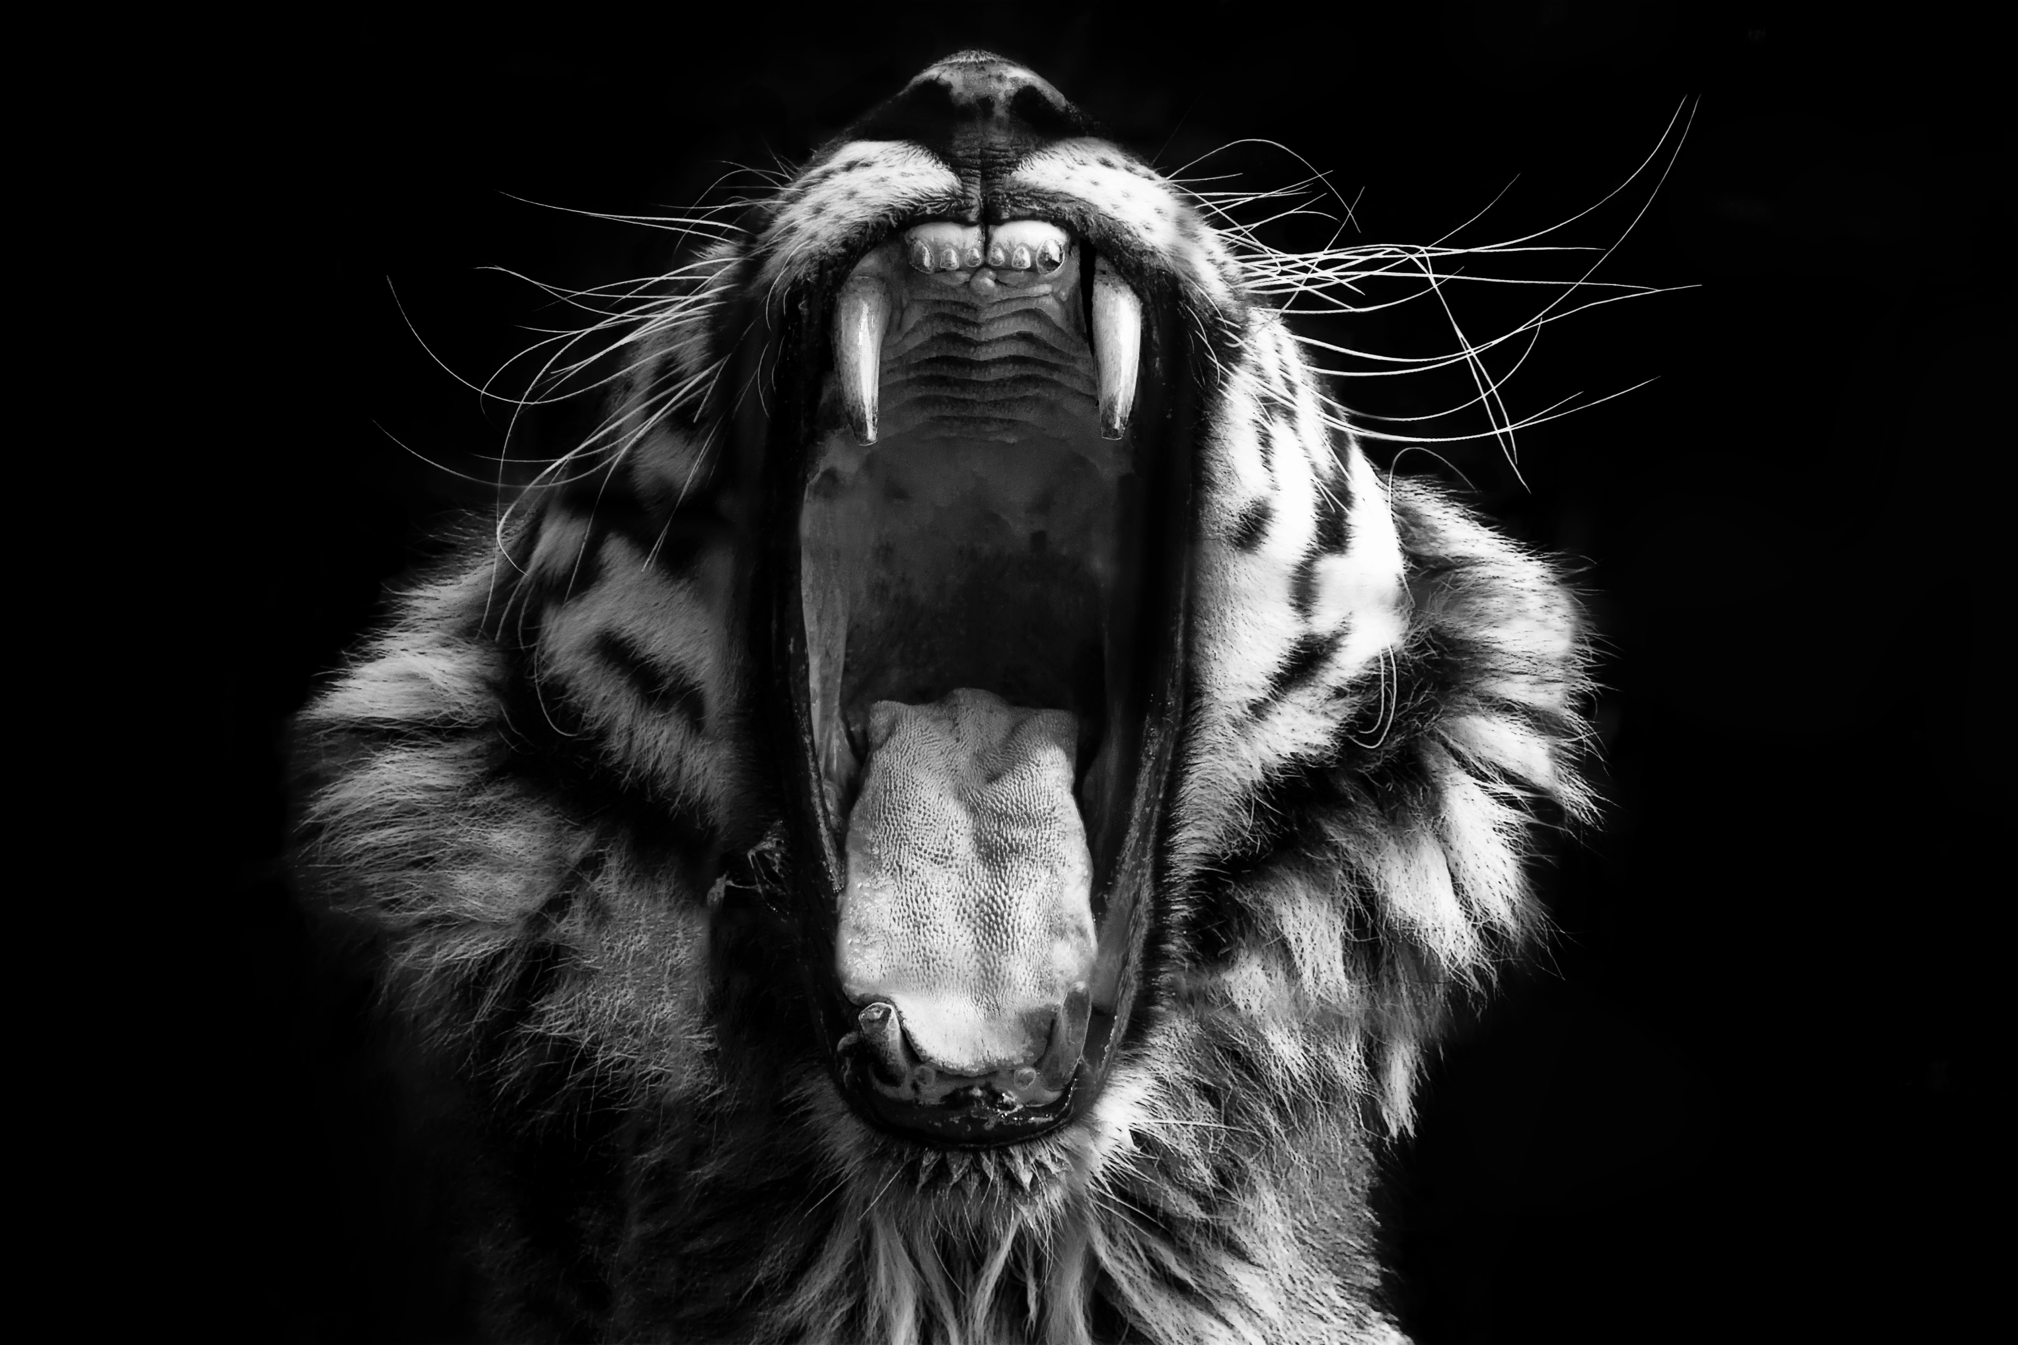
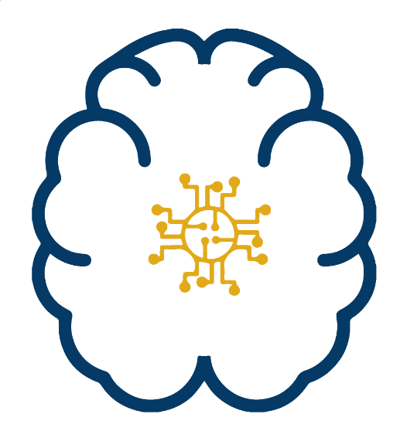

Connecting Neuroscience and Machine Learning
Don’t get Eaten by the Tiger
Dr John Butler
TU Dublin (Lecturer in Mathematics and Statistics)
TCD (Assistant Professor in Physiology)

Slide 2
Neuroscience
The study of the Brain

Slide 3
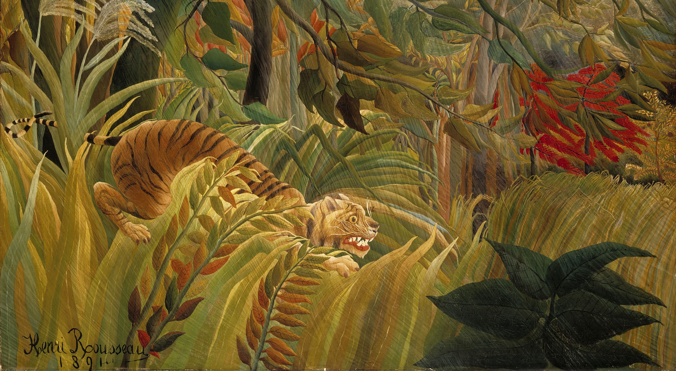
Visual System
Object Classification
Tiger or Tree
Motion Detection
Am I moving
Is the tiger moving
Motion Discrimination
Which Direction am I moving
Which Direction is the tiger

Slide 4
Questions for You
What is the brain made of?
Water
Protein
Fat
Veins
Glial Cells
Neurons

Slide 5
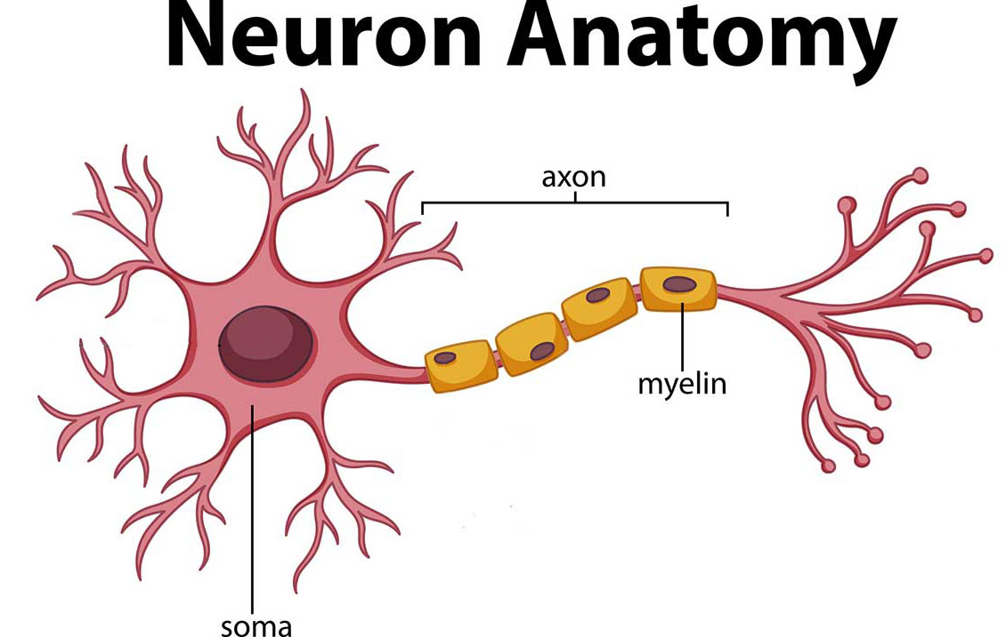
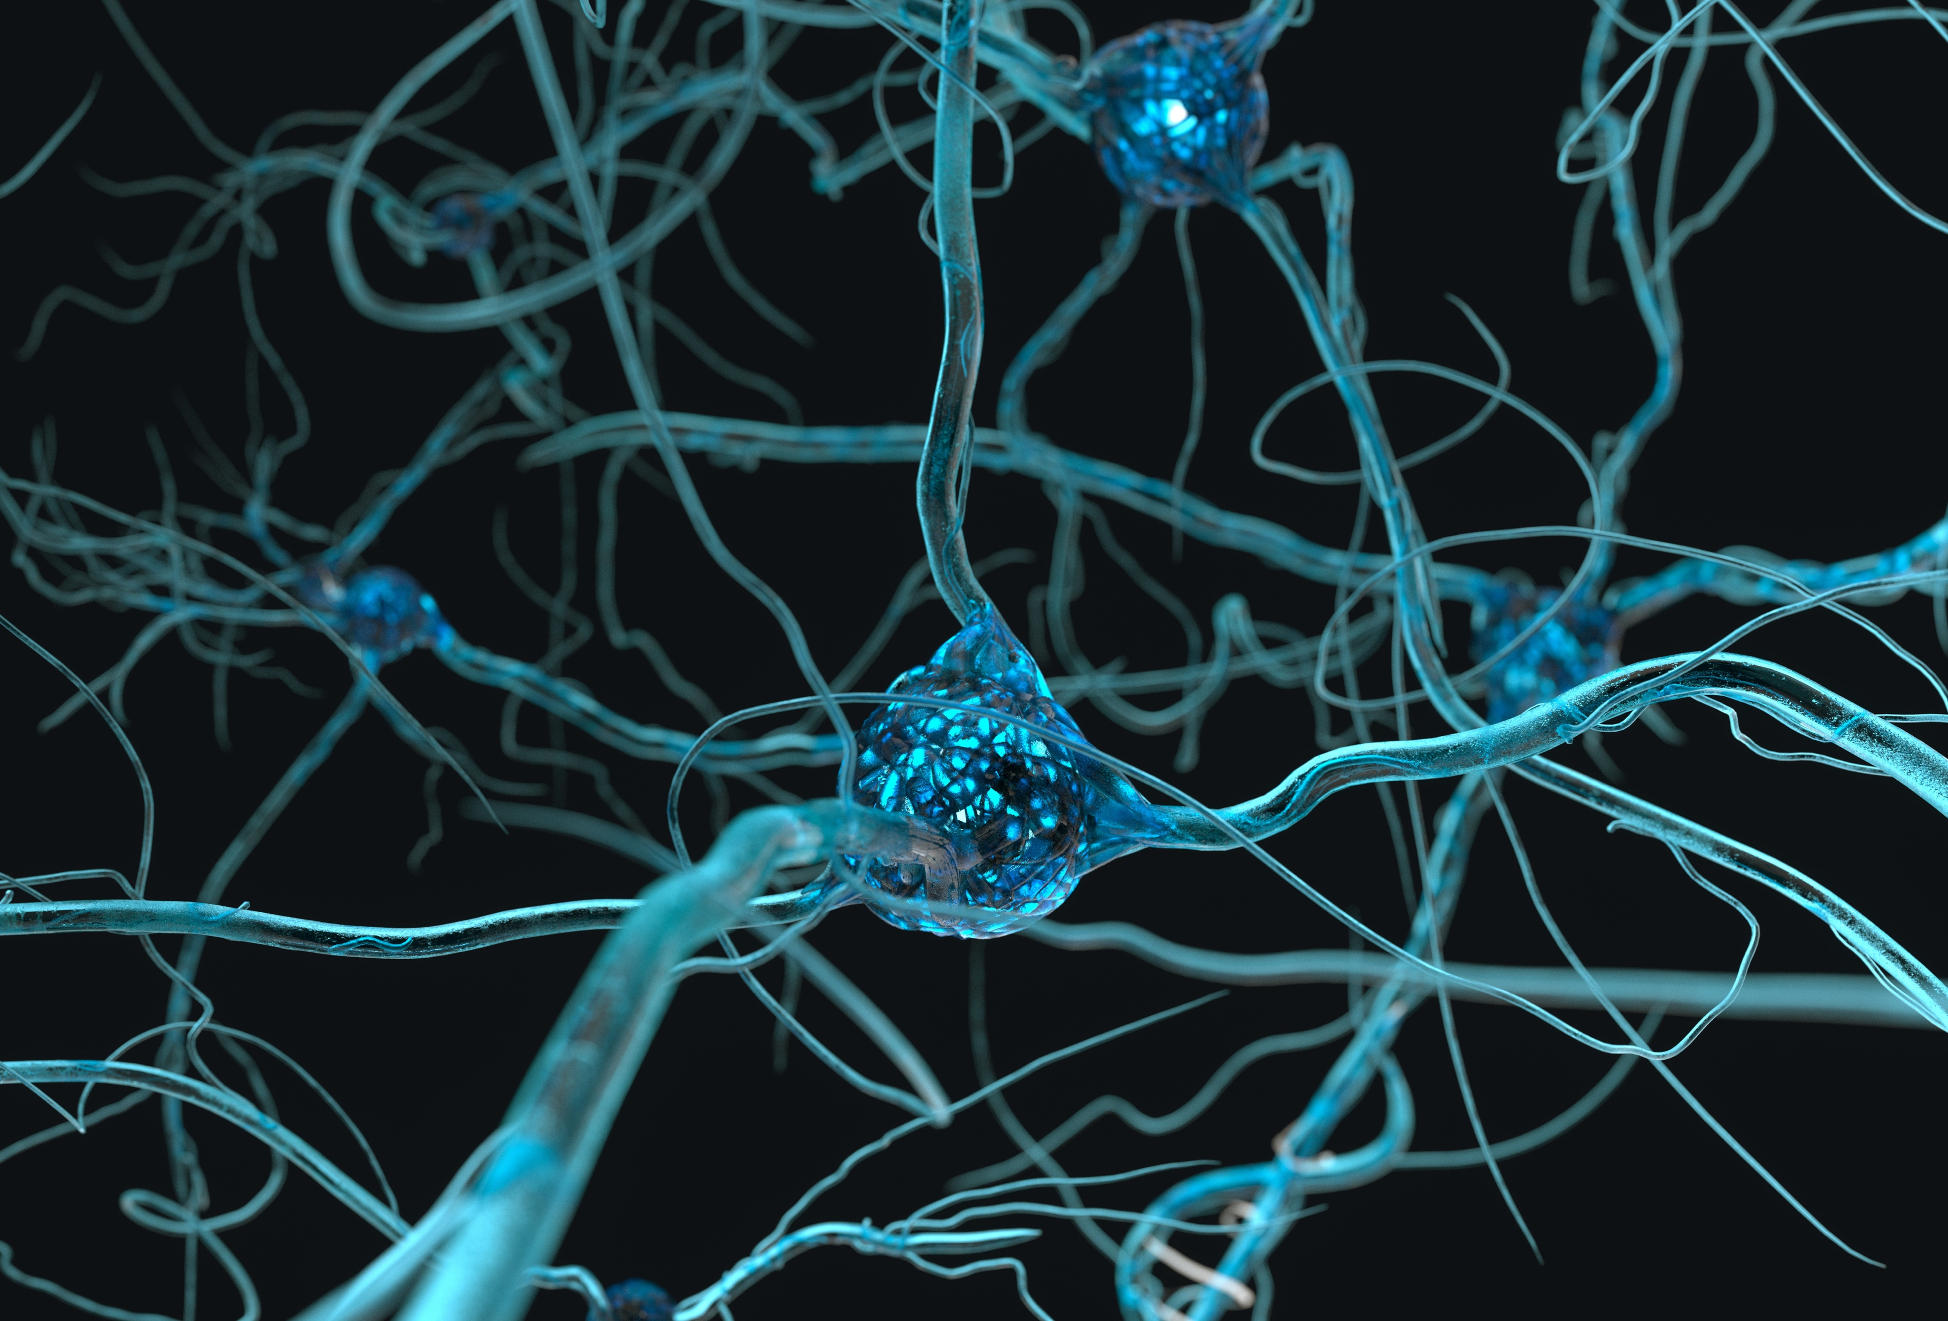
What Does a Neurons Look Like
How Many Neurons?
100,000,000,000

Slide 6
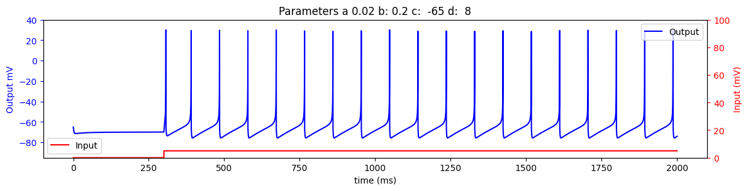

How Does a Neurons Work
Spike
0
1

Slide 7
Volunteer A Neuron

Slide 8
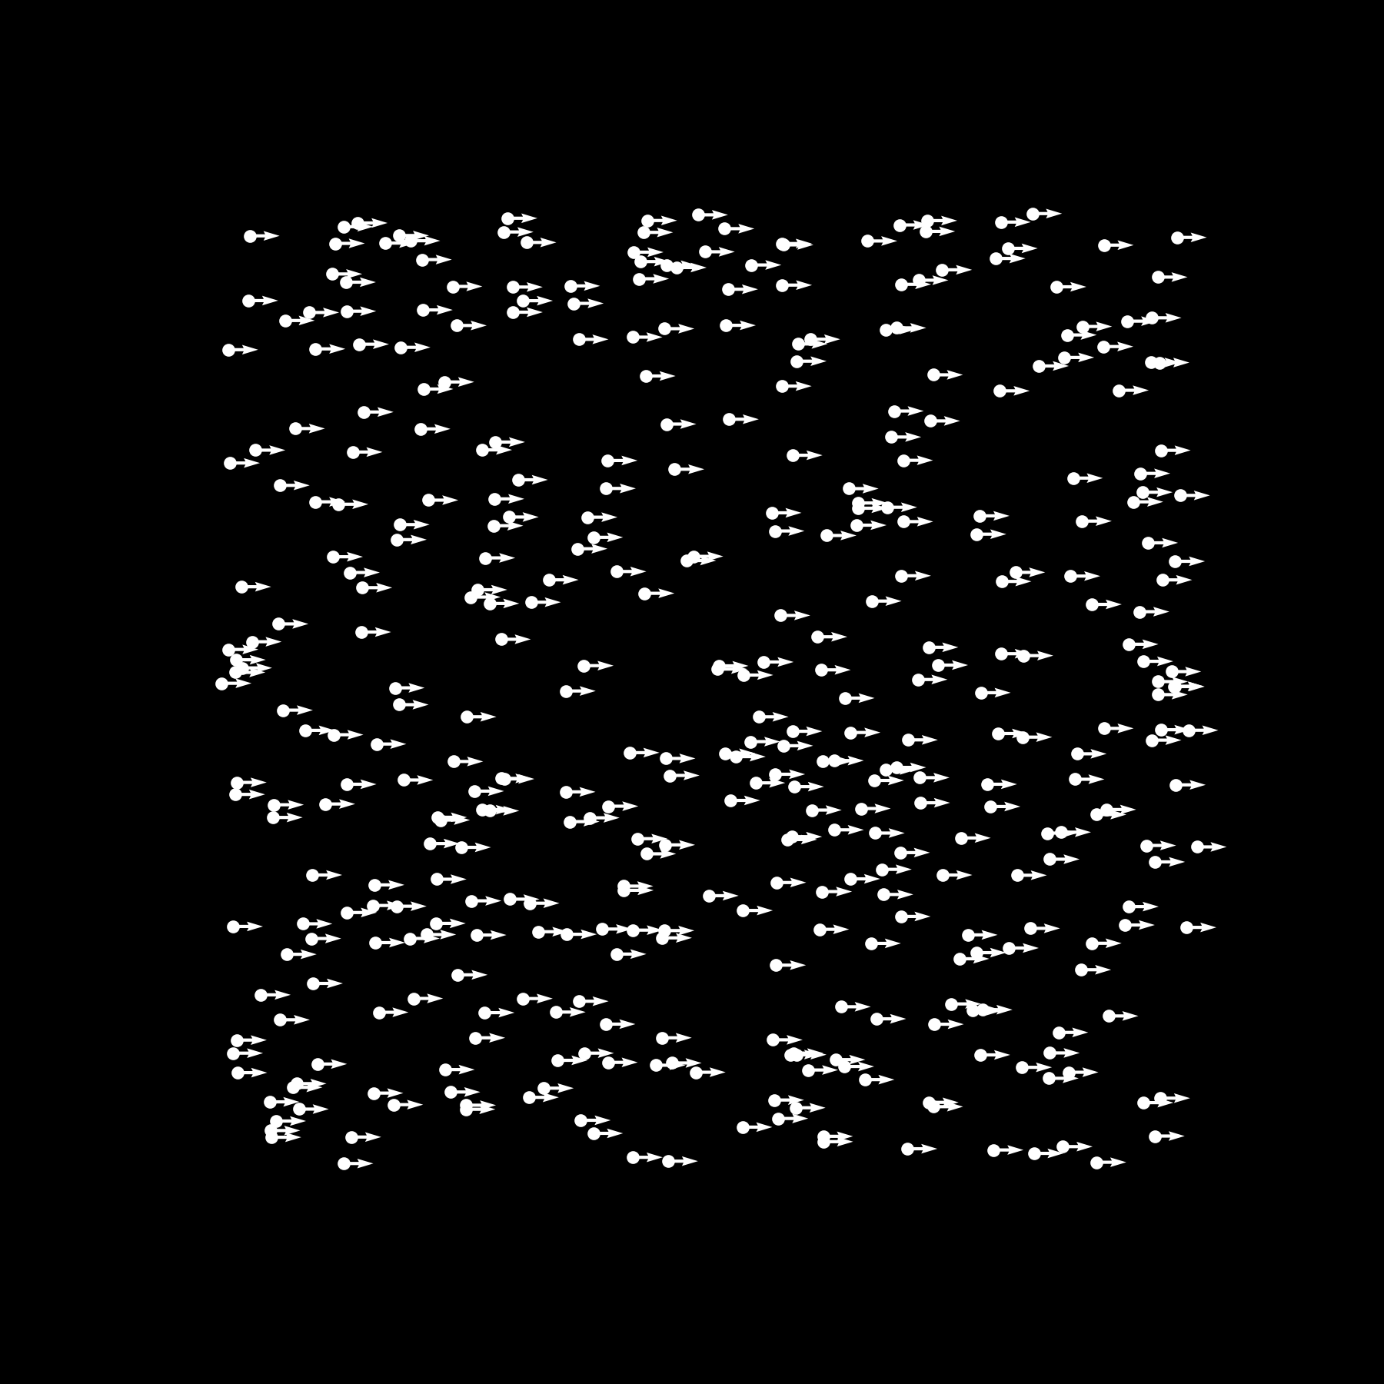
Is the Tiger Coming for Me

Slide 9
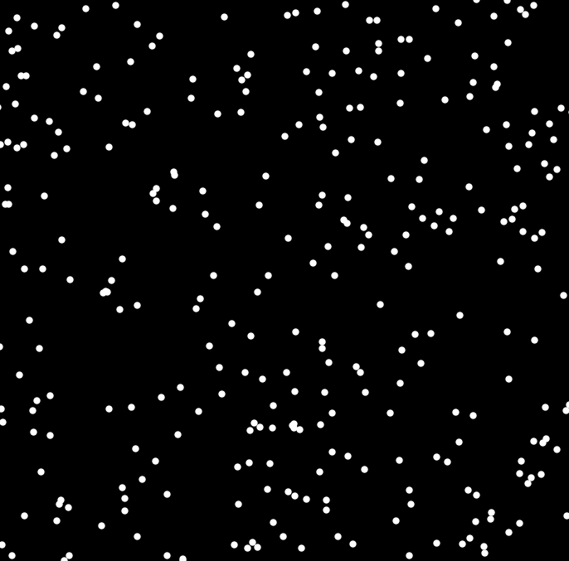
Left Or Right?
No Noise

Slide 10
How do Neurons Work Together?
100,000,000,000 Neurons
each with
10,000 connections
1,000,000,000,000,000 connections

Slide 11
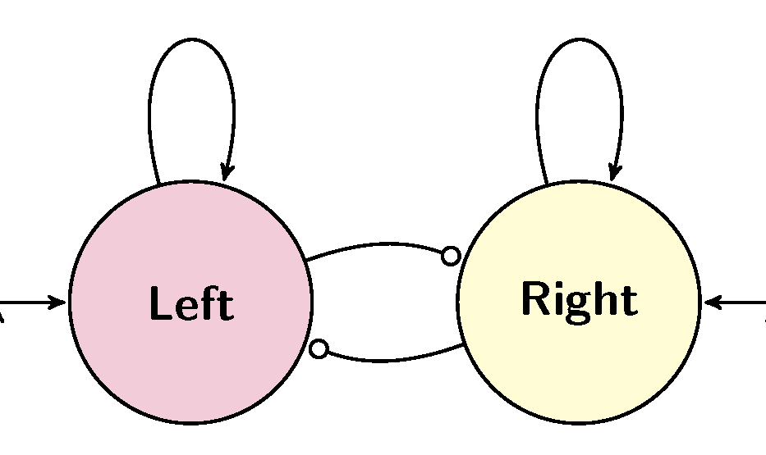
Two Areas
Let’s get a everyone to be two groups of Neurons
A Left side and a Right side
The most votes is the decision
But is it the correct decision

Slide 12
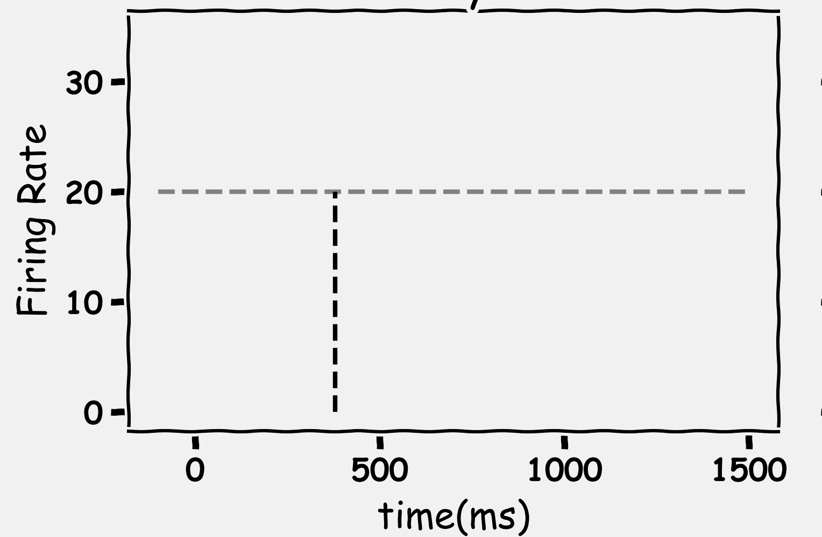
A Quick Decision
Time

Slide 13
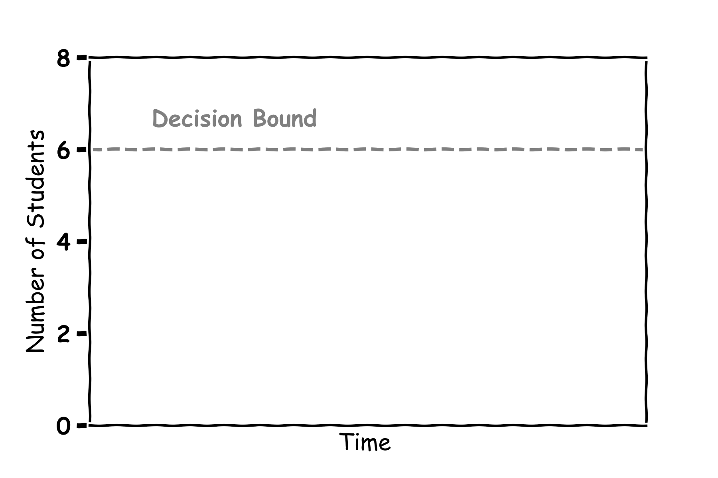
A Quick Decision

Slide 14
Left Or Right?
No Noise

Slide 15
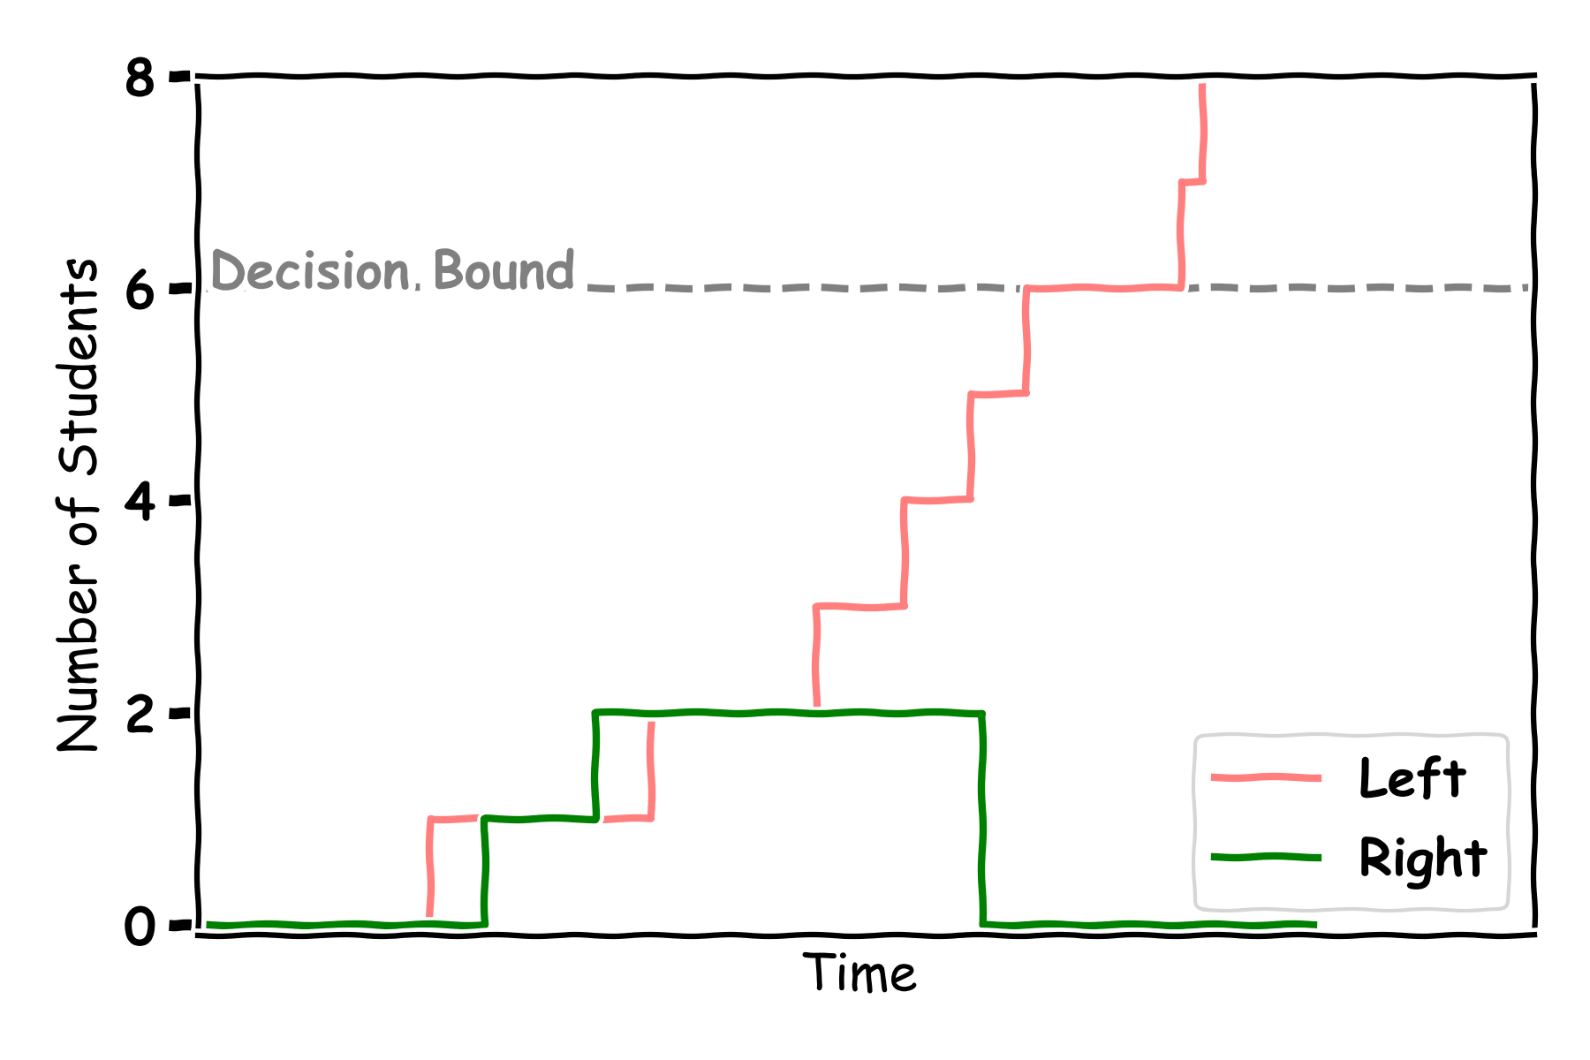
Left Decision

Slide 16
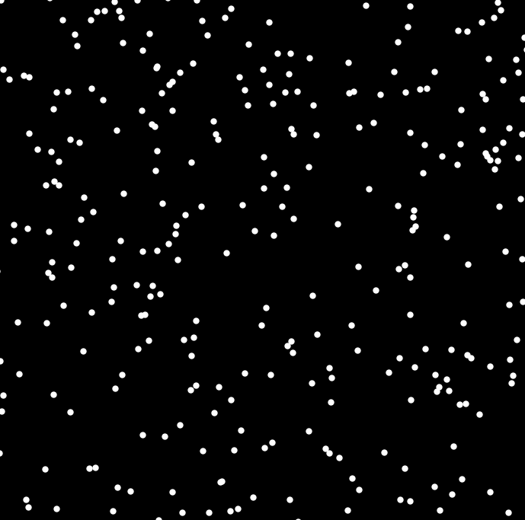
Left Or Right?
No Noise

Slide 17
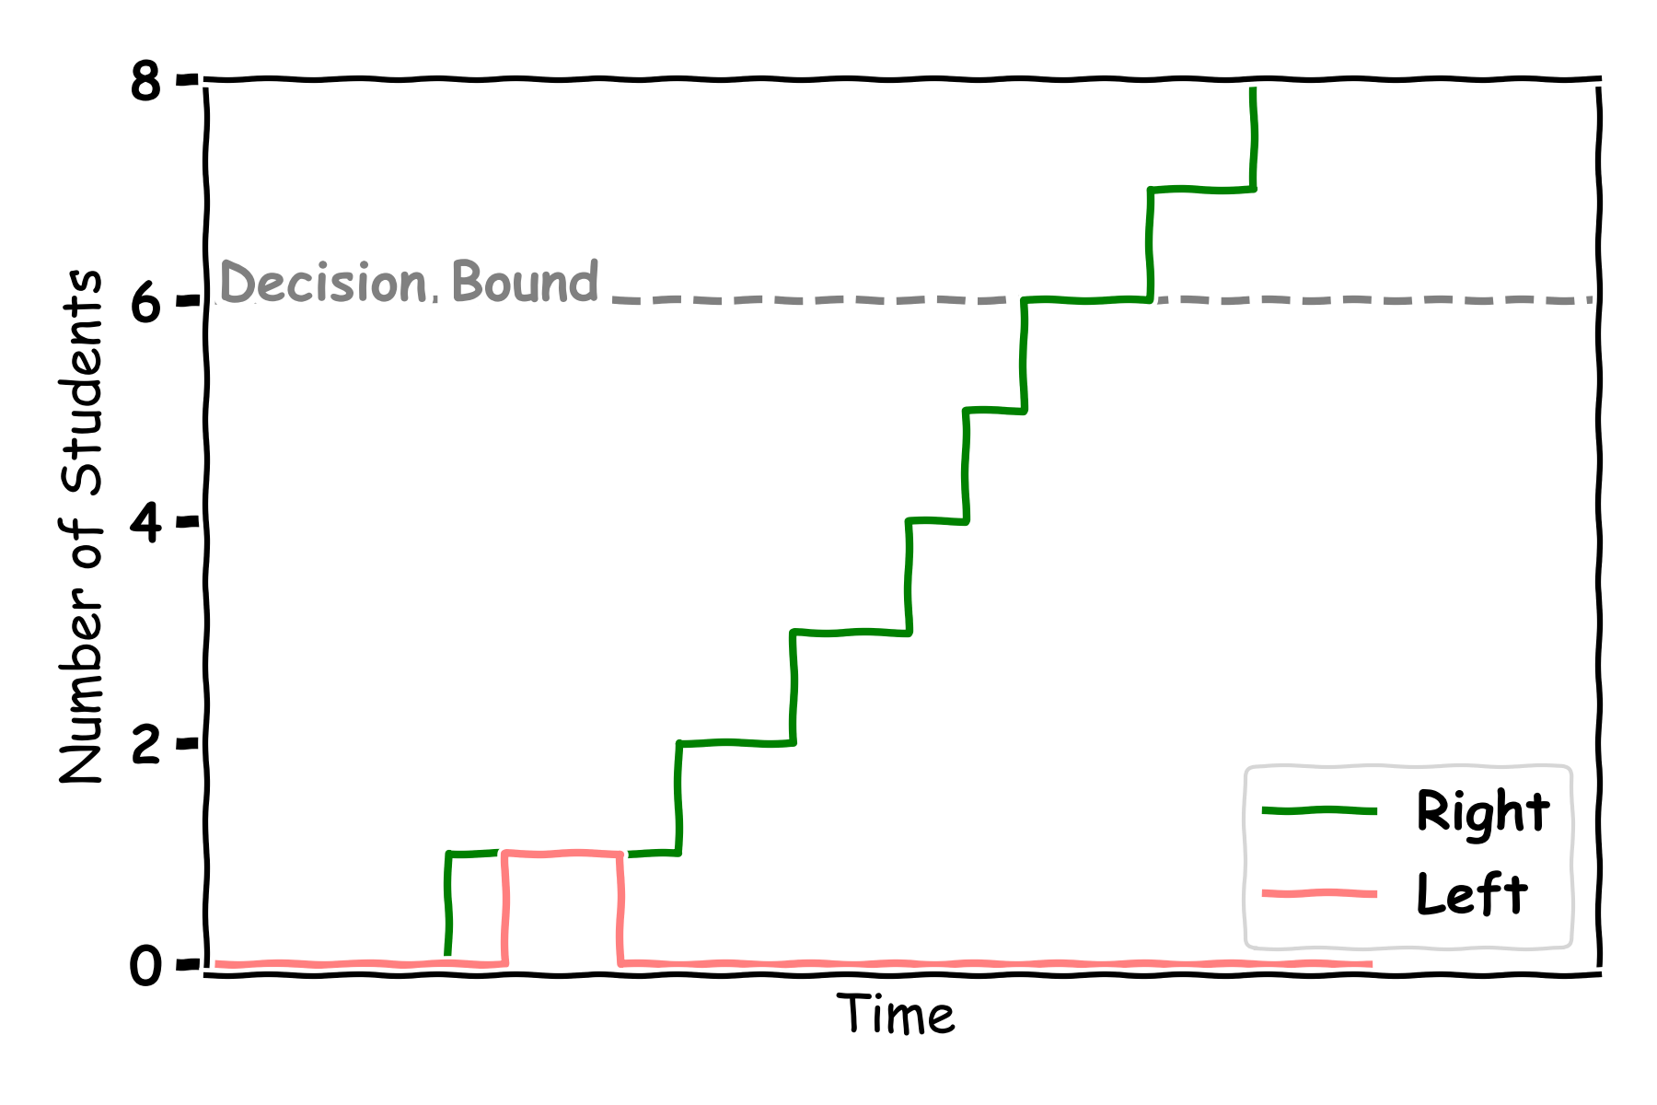
Right Decision

Slide 18
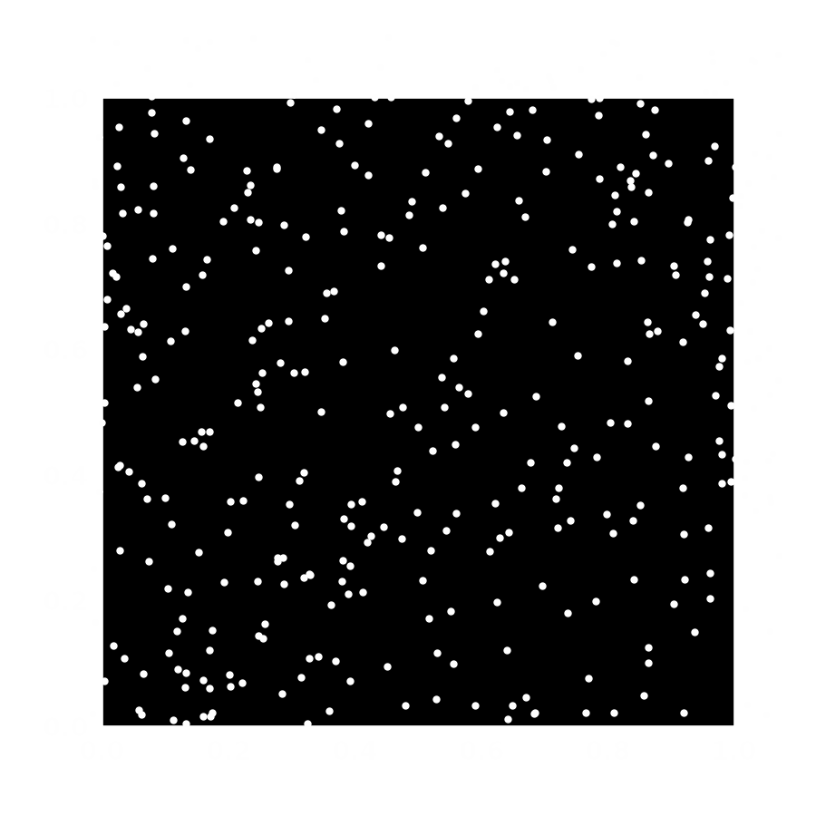
Left Or Right?
Right
Some Noise

Slide 19
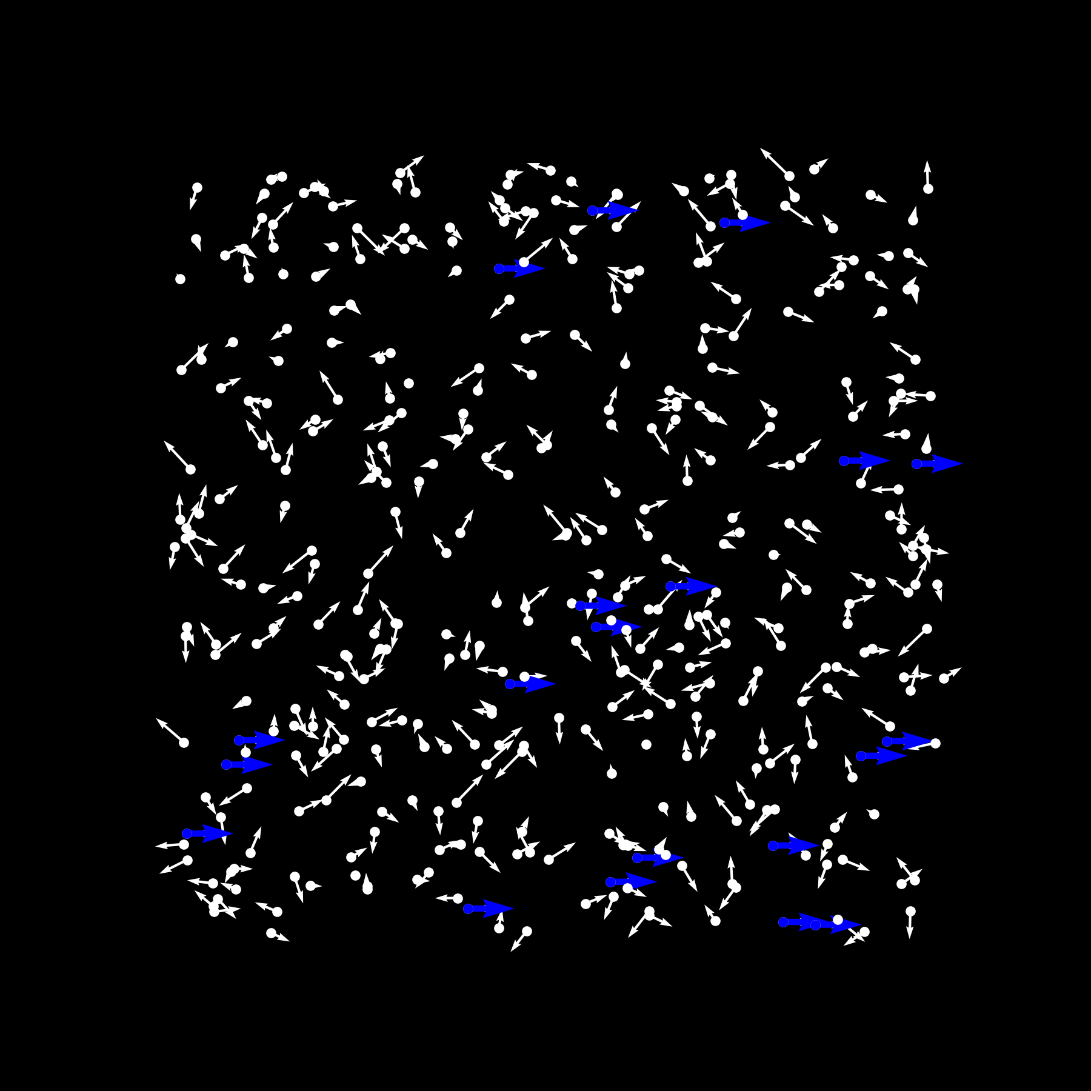
Snapshot
Right

Slide 20
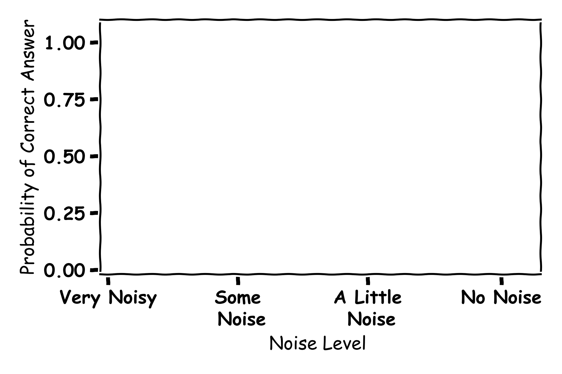
Noise

Slide 21
Left Or Right?
No Noise

Slide 22
Left Or Right?
No Noise

Slide 23
Left Or Right?
No Noise

Slide 24
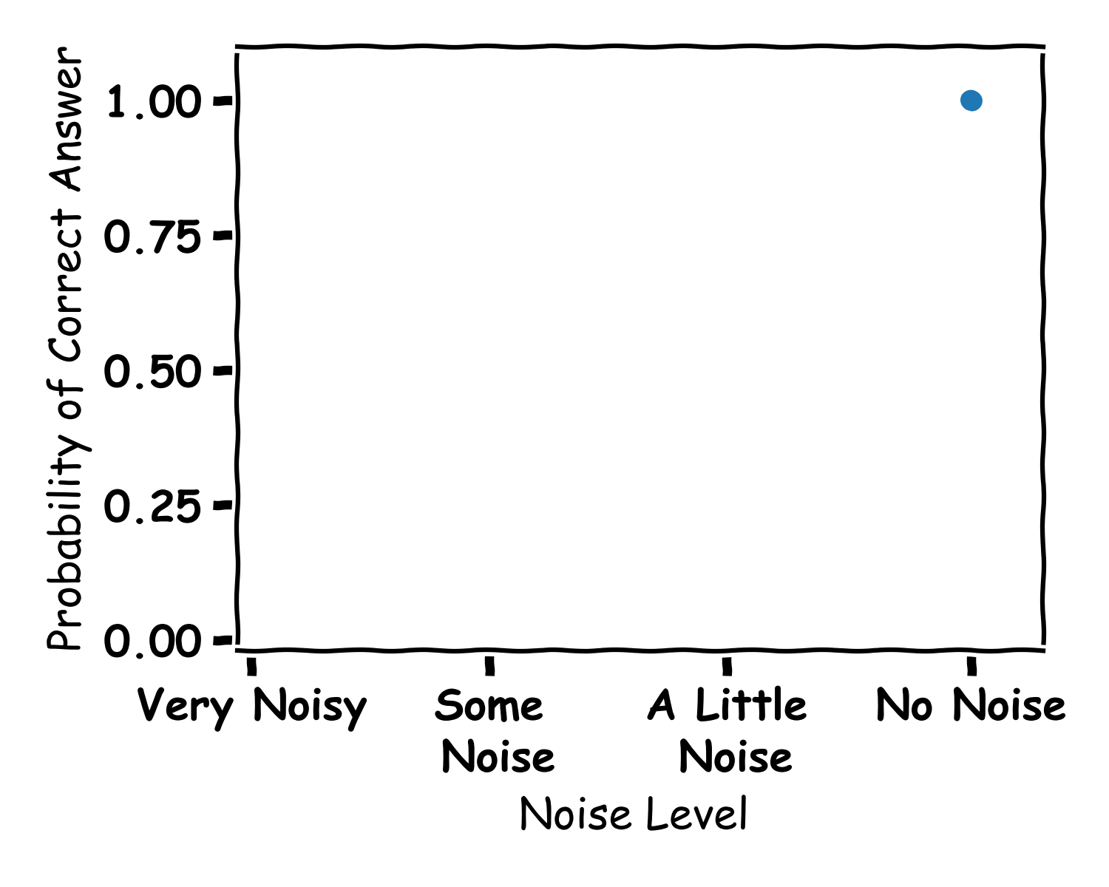
Answers

Slide 25
Left Or Right?
Right
A little Noise

Slide 26
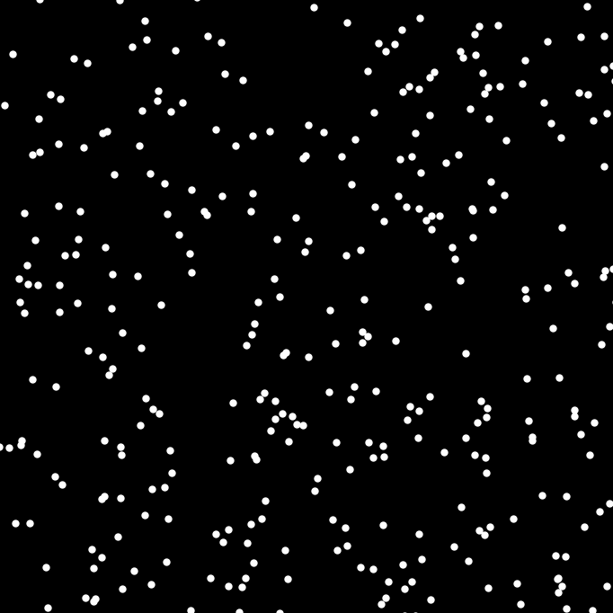
Left Or Right?
Some Noise

Slide 27
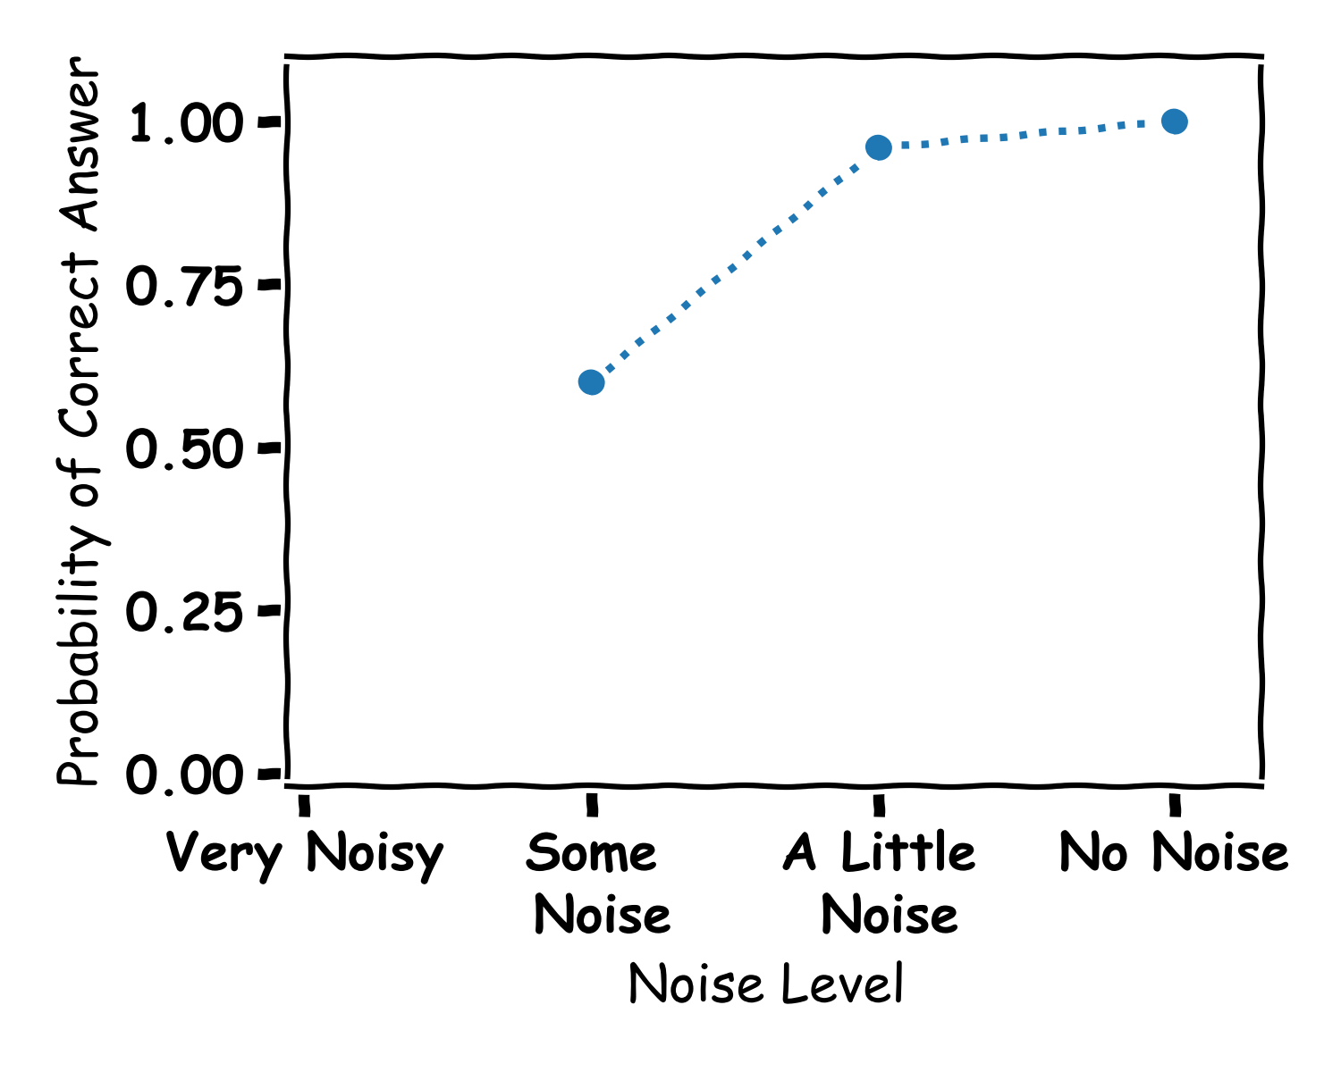
More Answers

Slide 28
Left Or Right?
Loads of Noise

Slide 29
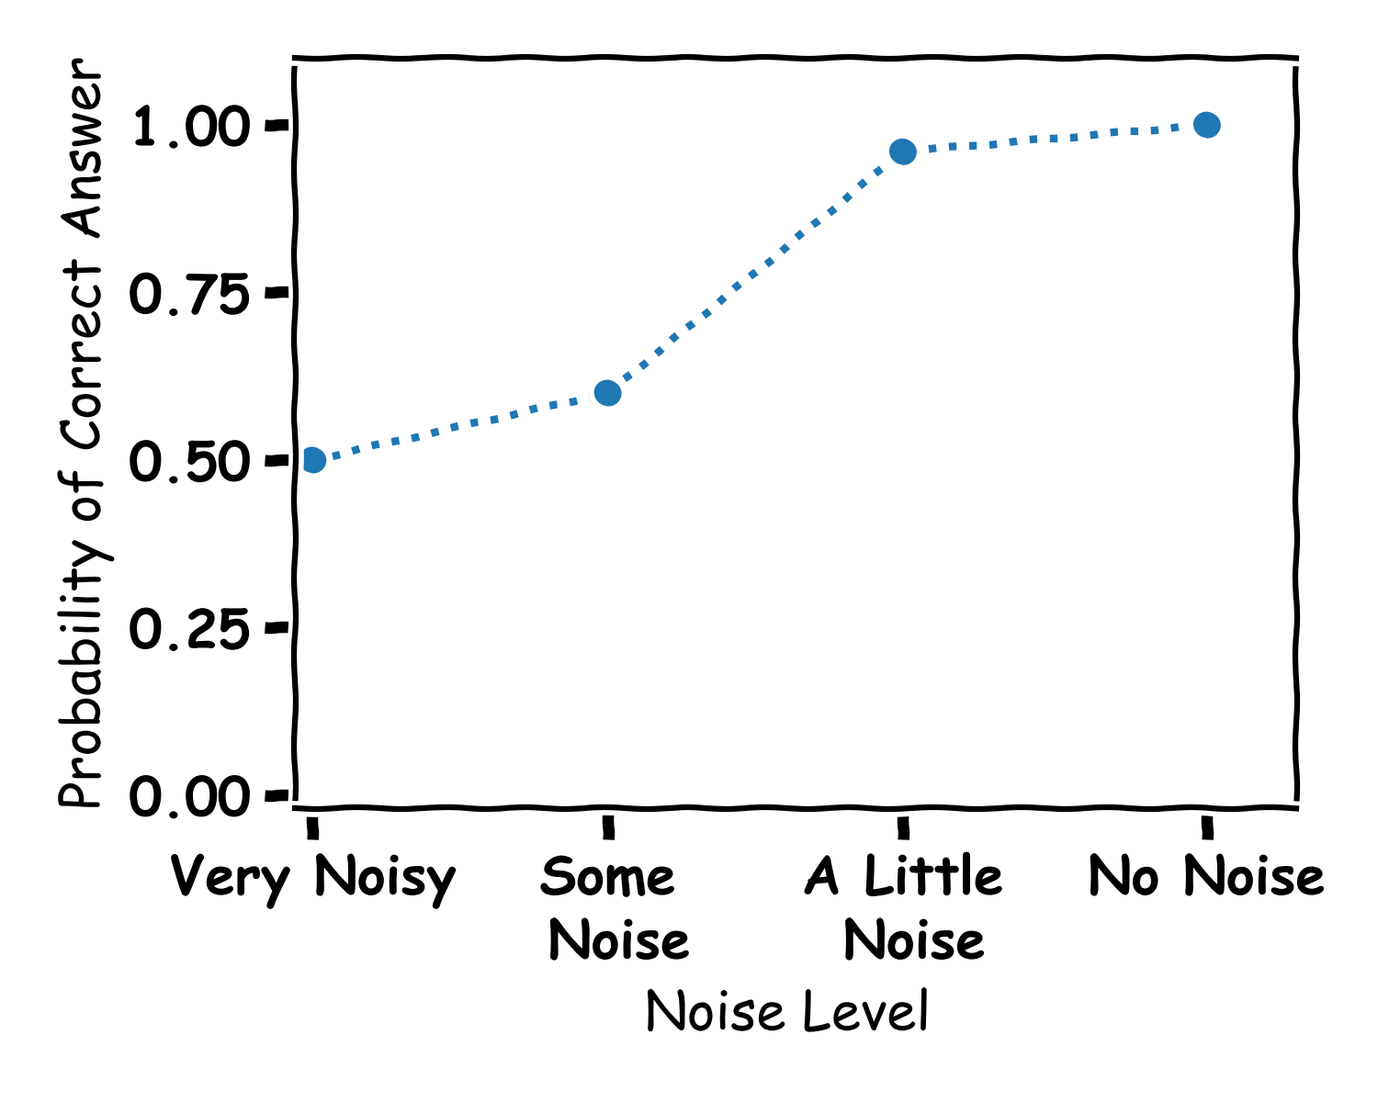
Answers

Slide 30
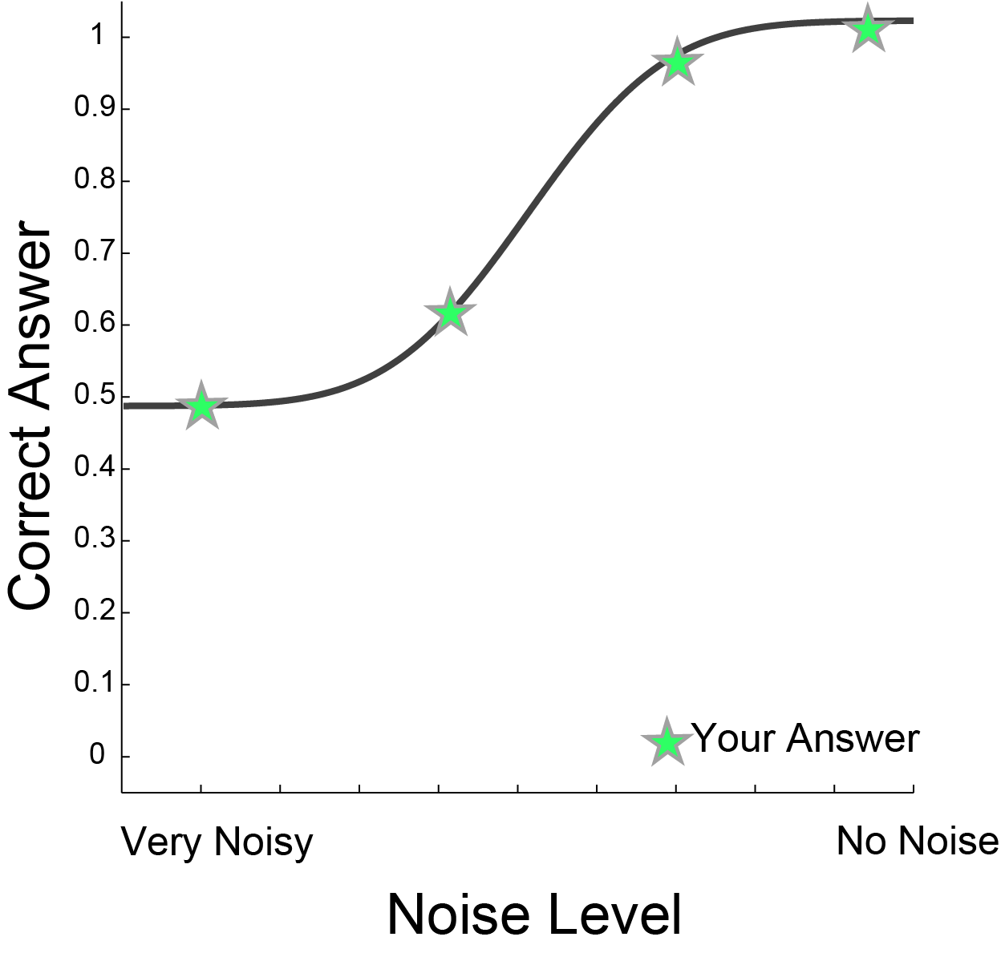
More Answers

Slide 31
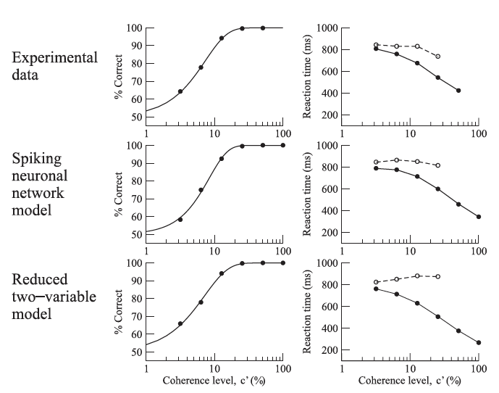
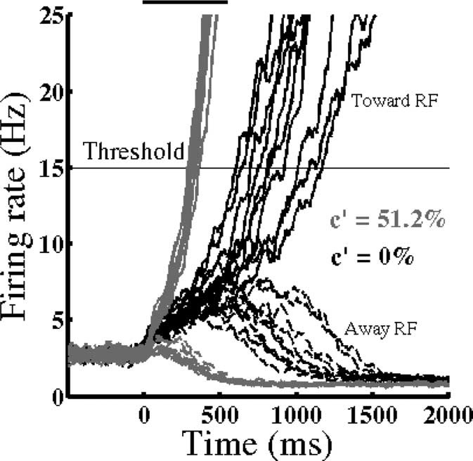
Modeling Directions
Model output
Mapped to Decisions
Wong and Wang 2006

Slide 32
Machine Learning
Algorithms

Slide 33
What is Machine Learning
Machine learning is teaching computers to learn and make decisions.
Well animals are good at learning and making decisions
Let’s try to do it like them

Slide 34
Visual System
Object Classification
Tiger or Tree
Motion Detection
Am I moving
Is the tiger moving
Motion Discrimination
Which Direction am I moving
Which Direction is the tiger

Slide 35
Perceptron (node)
Input
Node
Output
A BIT OF MATHS
0
1

Slide 36
Perceptron (node)
Input
Node
Output
A BIT OF MATHS
0
1

Slide 37
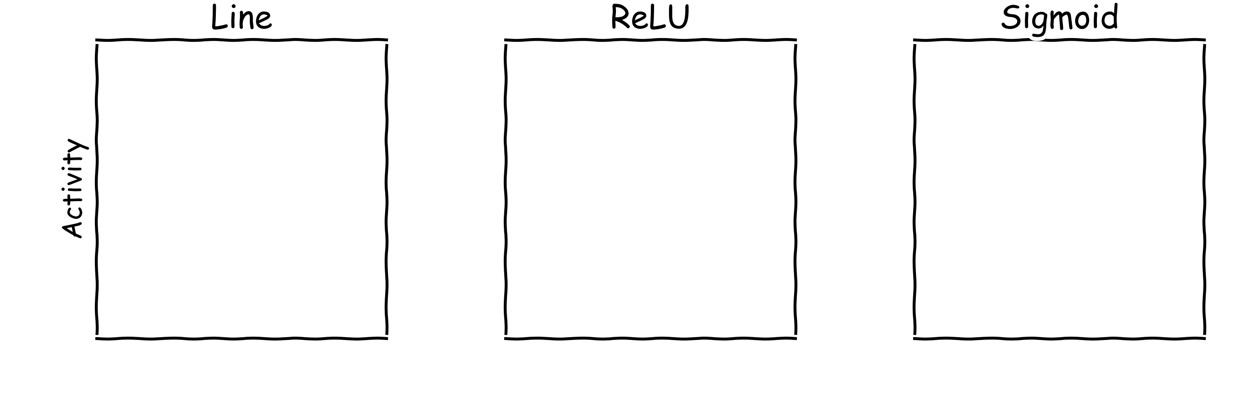
Activation Function

Slide 38
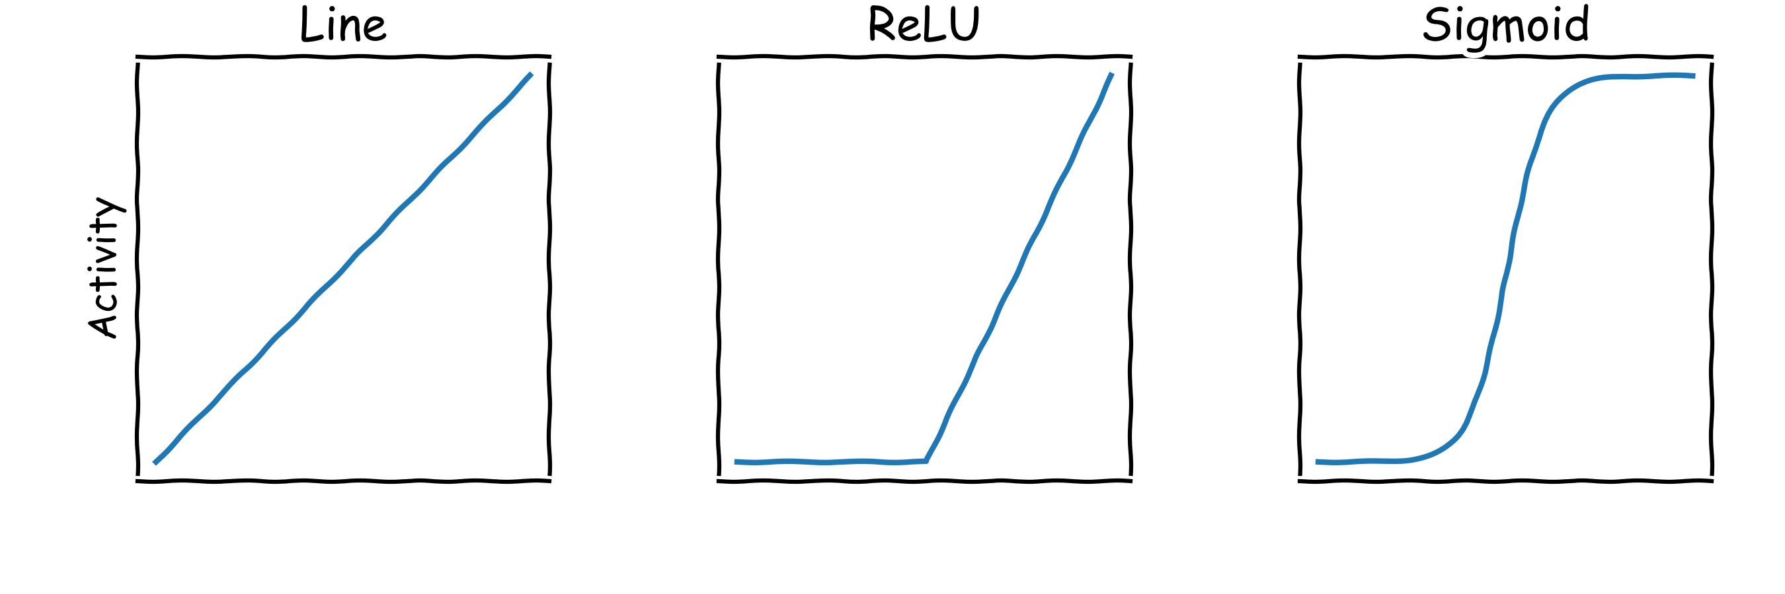
Activation Function

Slide 39
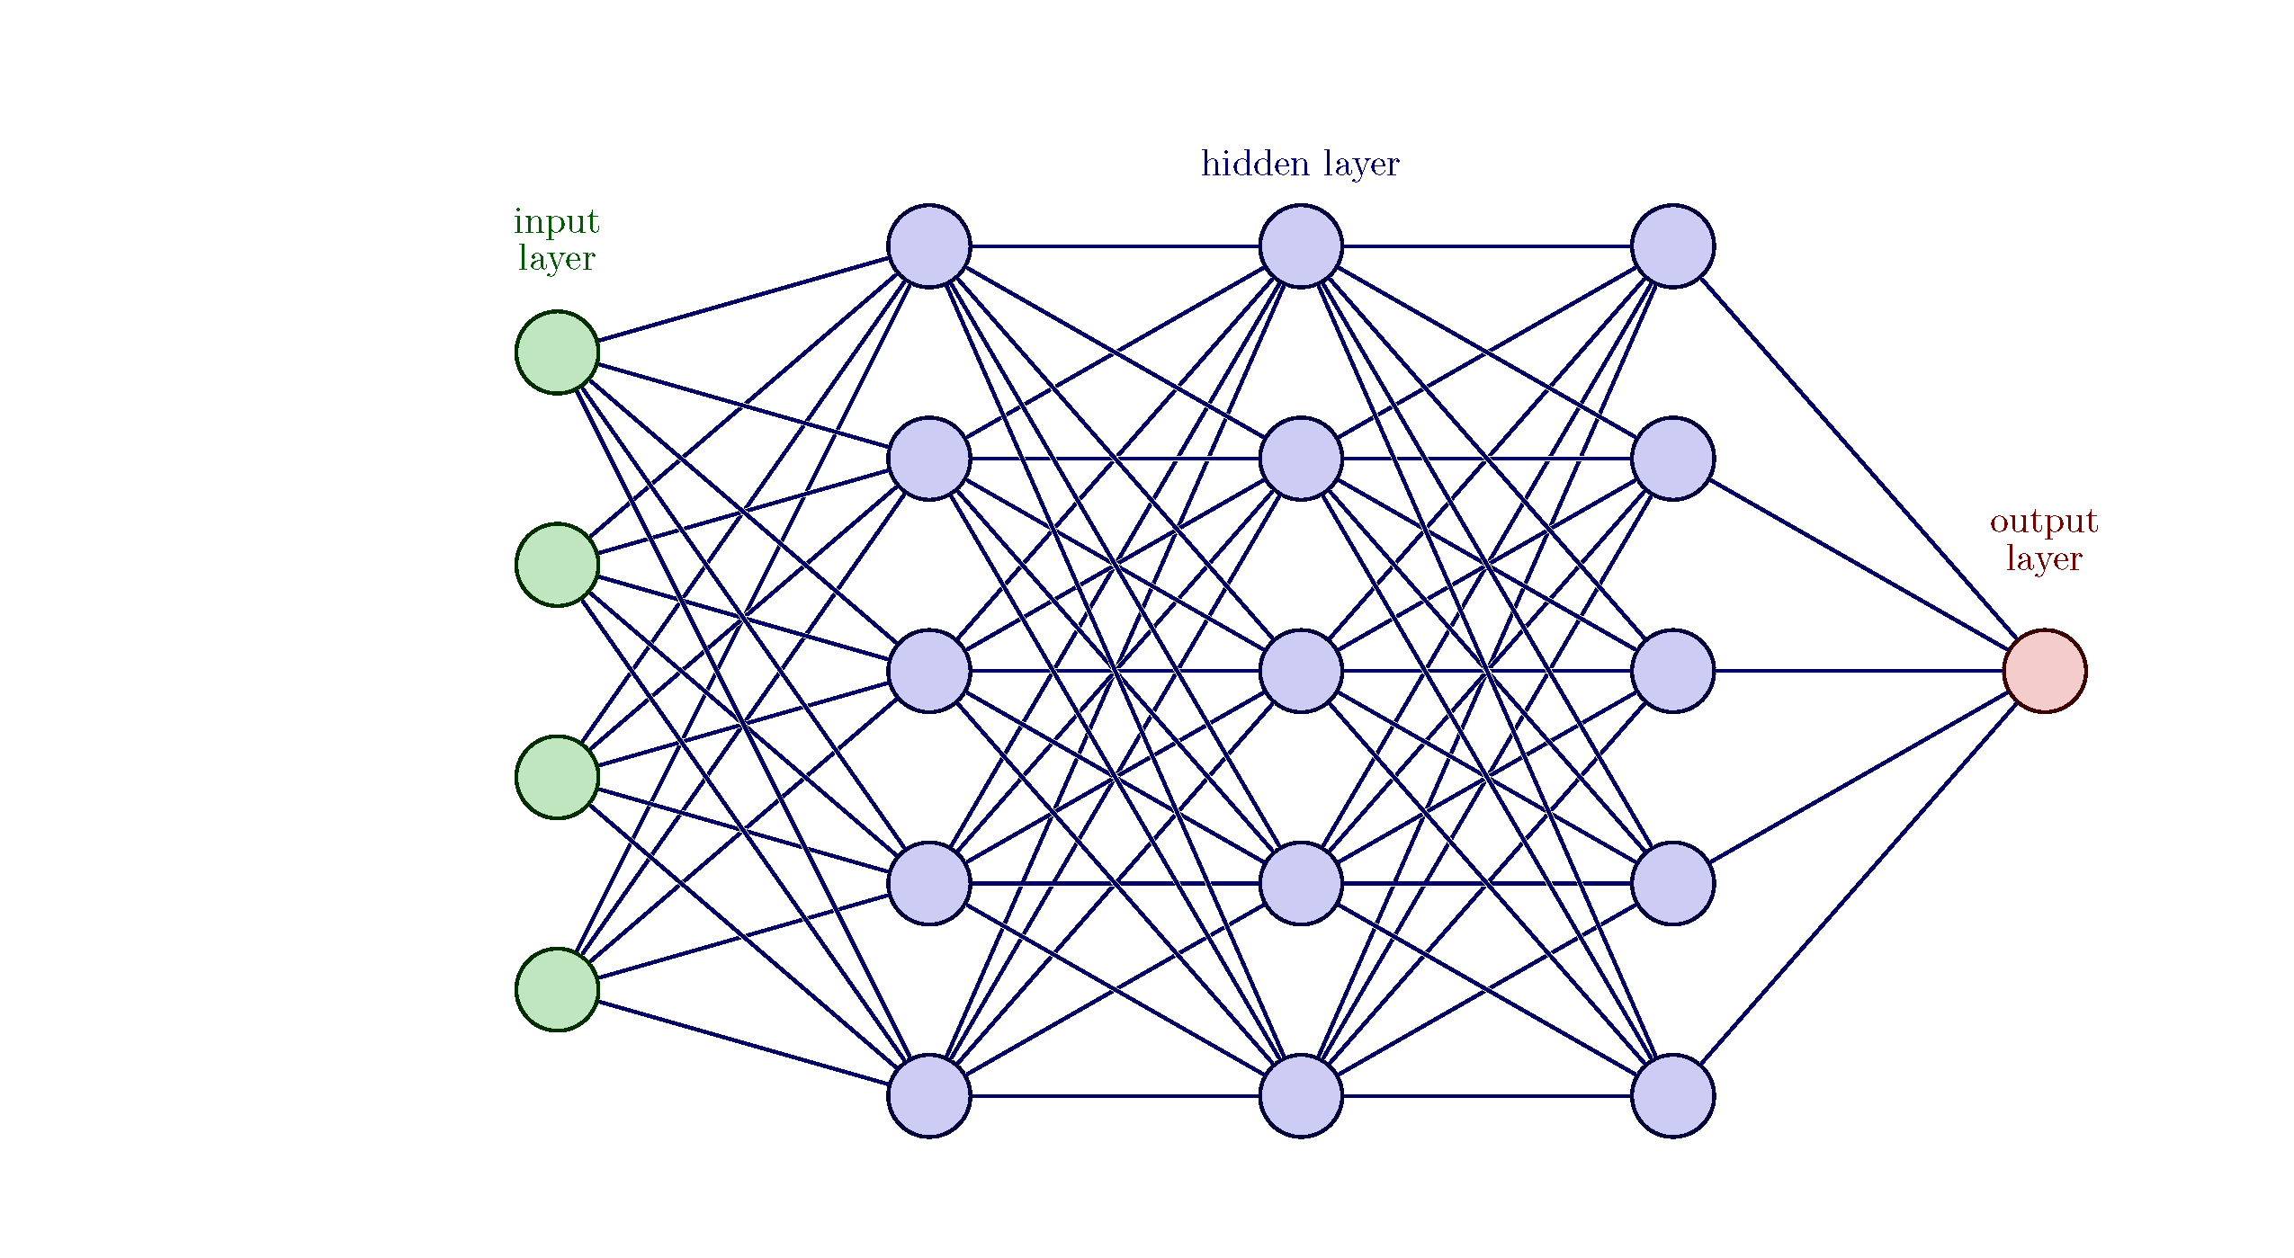
Loads of Nodes an Artificial Neural Network
Input
Neural Network
Output

Slide 40
How does it learn?
It must learn the connections
Input
Neural Network
Output

Slide 41
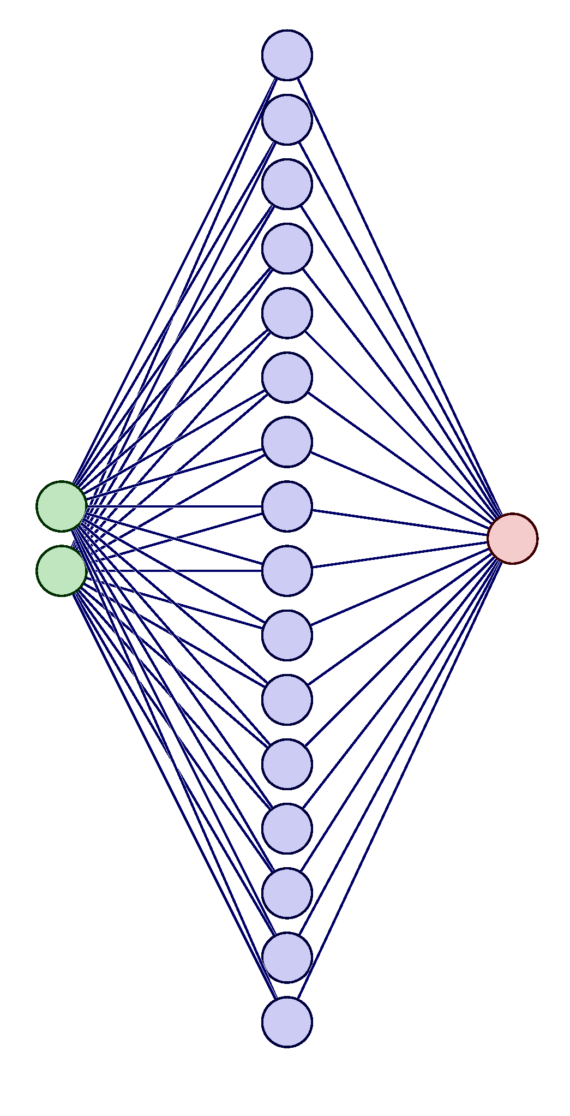
How does it learn?

Slide 42
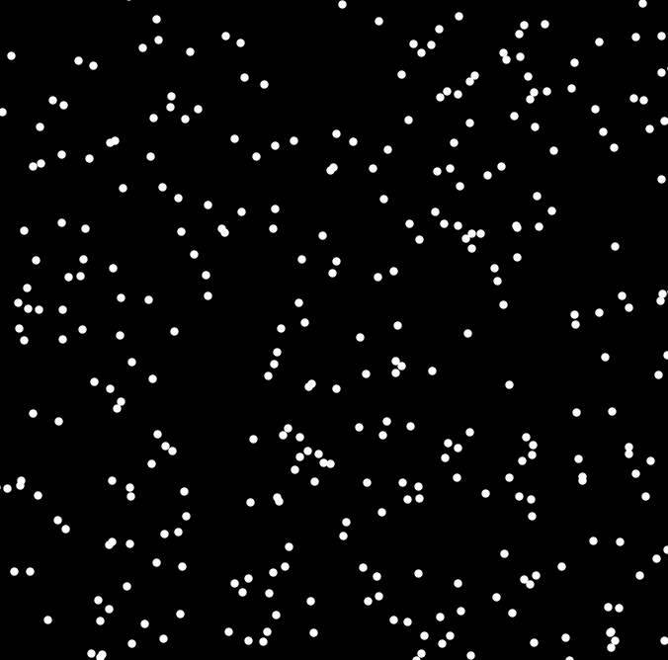
Left Or Right?
Some Noise

Slide 43
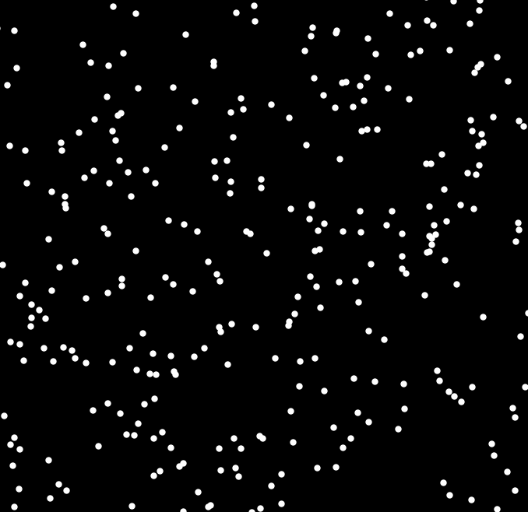
Left Or Right (again)?
Some Noise

Slide 44
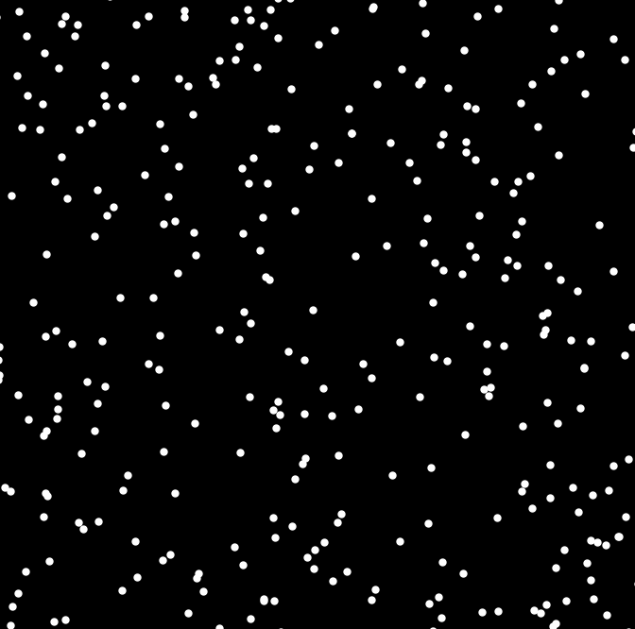
Left Or Right (again and again)?
Some Noise

Slide 45
What does it learn?

Slide 46
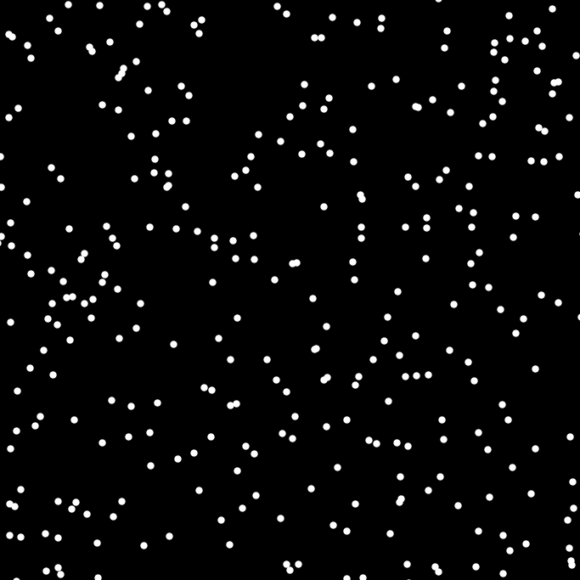
Left Or Right?

Slide 47
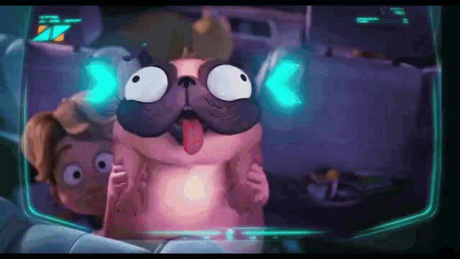
Neural Networks
You are smarter than a computer
Cannot answer if it is not trained on (seen) it

Slide 48
Uses of Neural Networks
Image Recognition
Speech Recognition
Playing Games.
Creating Art
Language Translation.
Medical Diagnosis.

Slide 49
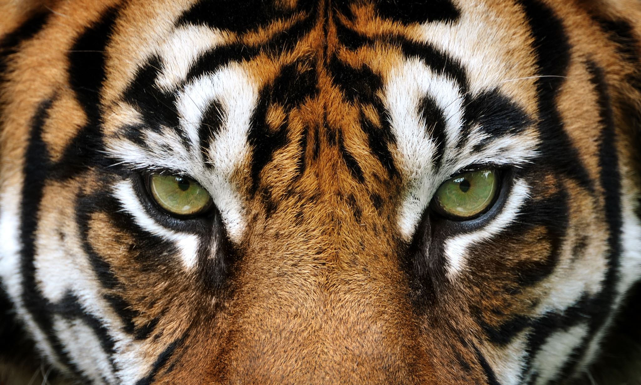
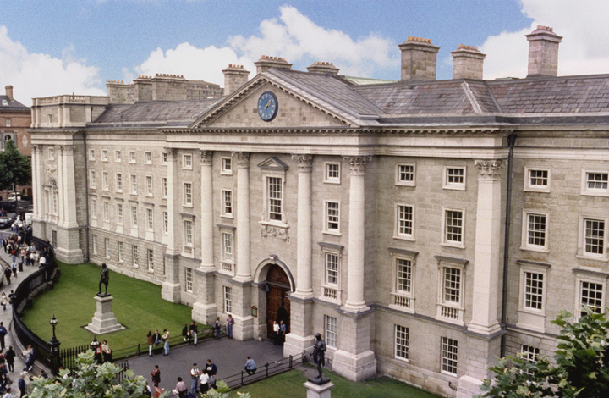
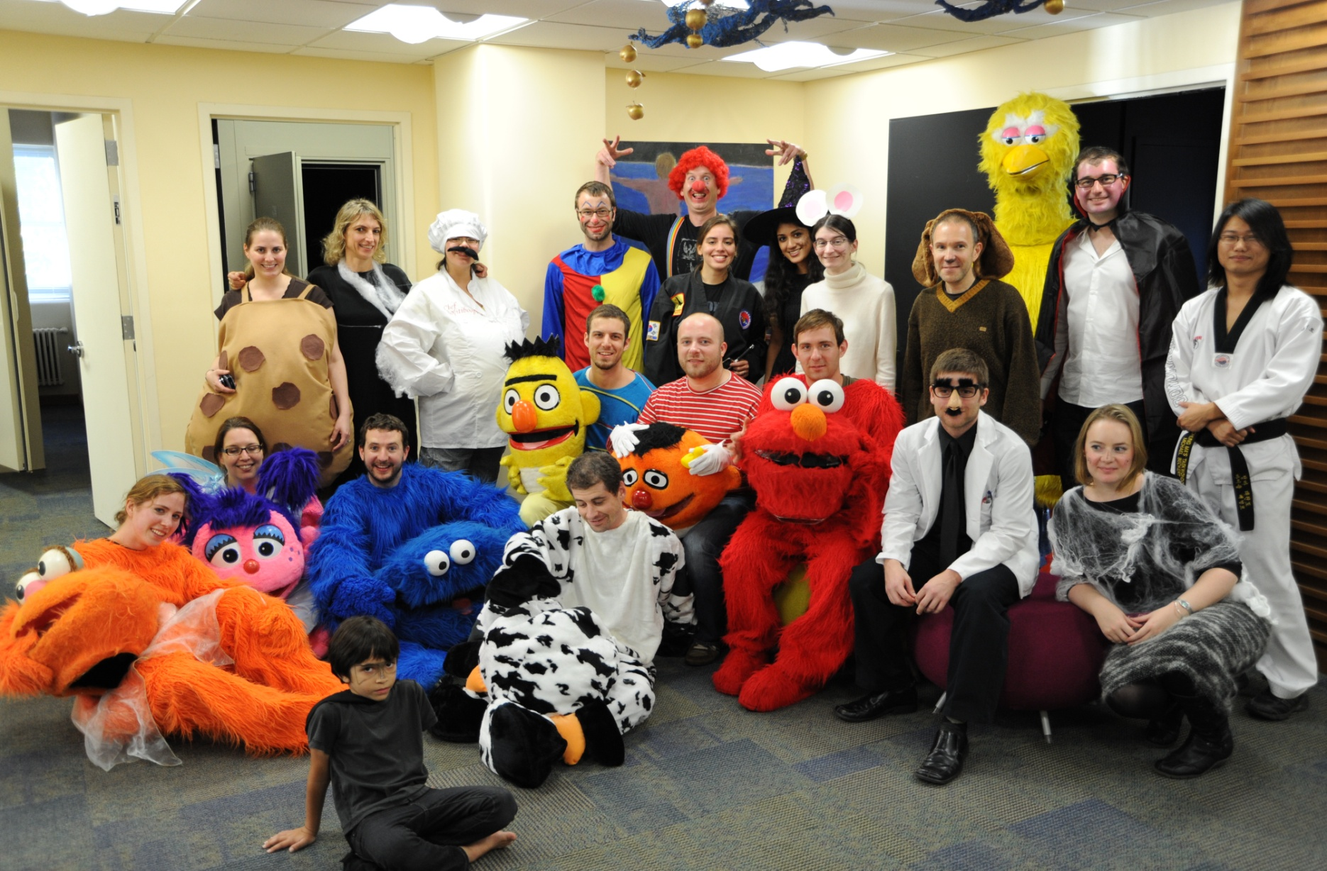
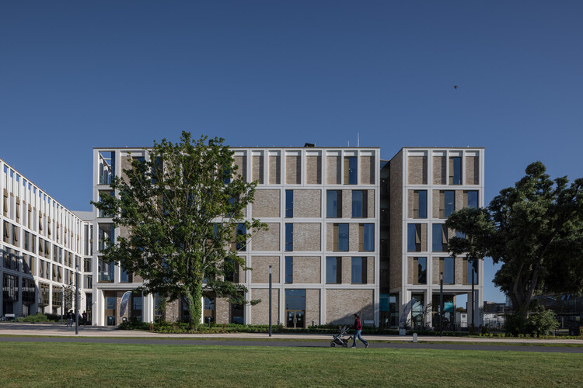
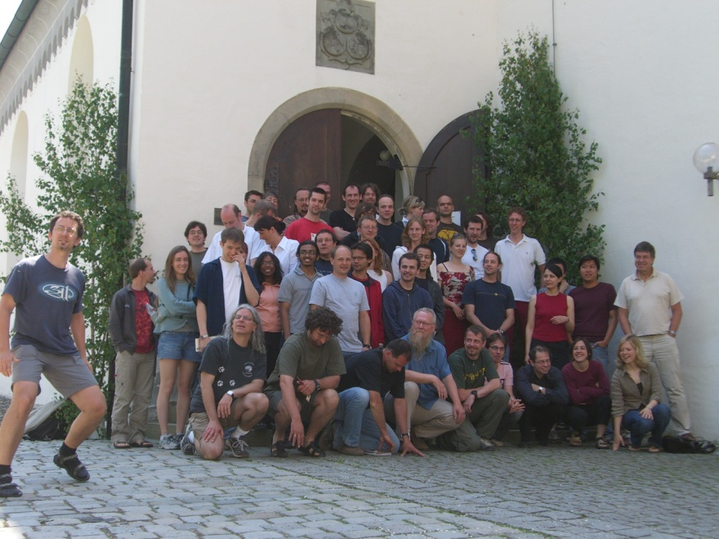
Thank you for Listening
TCD
Albert Einstein College of Medicine
TU Dublin
Max Planck Institute Germany

